Slide 2
Bentum, ten Bosch, Lentz 2024
Listeners use stress to facilitate word recognition and speech segmentation. Classical ASR systems did not incorporate stress in their recognition process.
We showed that Wav2vec 2.0 is sensitive to stress, and that this sensitivity is not a mere reflection of acoustic correlates of stress.
Diagnostic classifiers of the CNN output reveal vowel-specific stress representations, that perform on par with acoustic features.
Stress classifiers trained on transformer layers outperform classifiers based on acoustic correlates, but degrade when context is removed, showing that higher layers take the relative nature of stress into account.

Slide 3
Research questions
To what extent does the information carried by acoustic correlates of stress percolate through the CNN layer?
Do the Transformer layers process this information and take context into account, improving stress sensitivity?
And if so, do the Transformer layers capture stress as one common feature that each syllable may have, or do they instead recognize stressed and unstressed versions of each phoneme separately?
We hypothesize: used → useful

Slide 4
Model, data
For all experiments we used a publicly available pre-trained W2V model wav2vec2.0
We used the MALD-corpus, containing 26,793 English words (we excluded the pseudowords).
The words were recorded in isolation, spoken by the same 28 year old North American male speaker. There is one recording per word and all word recordings were down-sampled to 16 kHz.

Slide 5
For the vowels in stressed and unstressed syllables in the Complete Dataset, we computed values for the following acoustic correlates of stress: Intensity, Duration, Formants, Pitch and spectral balance. For each feature, the distribution of values for both stressed and unstressed vowels can be seen in Figure 1. Intensity: We computed the mean Intensity (dB) of each vowel as follows 10 log10(x2/4 ∗ 10−10), whereby x denotes the audio samples corresponding to the vowel. Duration: The duration of each vowel was based on the time-aligned phoneme transcriptions of the MALD-corpus [18]. Formants: We operationalized peripherality of formant frequencies as the Euclidean distance of the mean F1 and mean F2 of each monophtong vowel to the global mean F1 and F2 of all monophtong vowels. F1 and F2 values for all monophtong vowels in the Complete Dataset were computed with Praat [21]. Pitch: We computed the mean pitch for each vowel with the Librosa Python package [22] (version 0.10.1). Spectral: We defined spectral balance according to [5] and computed the intensity (dB) in four consecutive frequency bands (0 - 500, 500 - 1000, 1000 - 2000, 2000 - 4000). Based on these intensity values, we applied a linear discriminant analysis (LDA) as implemented in the scikit-learn Python package [23] (version 1.3.0), to distinguish between stressed and unstressed vowels. The first linear discriminant (LD1) score for stressed and unstressed vowels is shown in Figure 1. For each of the acoustic correlates of stress we trained 100 classifiers on random splits of the data into training (67%) and test (33%) sets. In addition to previously mentioned features, we added F1-F2 (mean F1 & mean F2) as a separate feature. Furthermore, we created the Combined feature, which consists of the features: Intensity, Duration, Pitch, F1-F2 and Spectral balance (consisting of the intensity of 4 frequency bands).

Slide 6
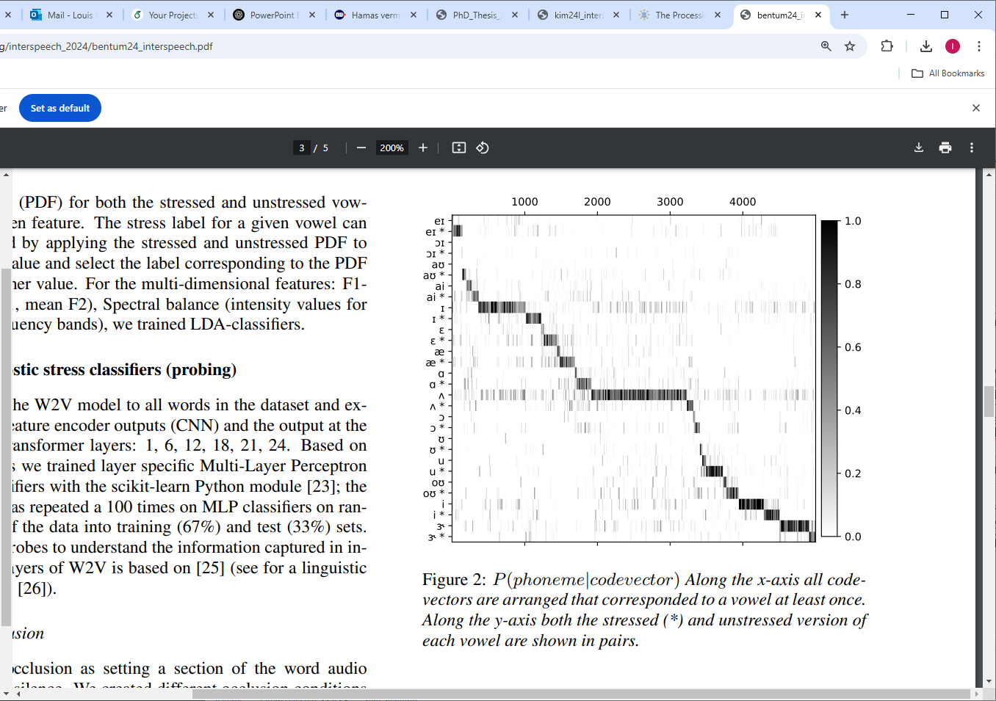

Slide 7
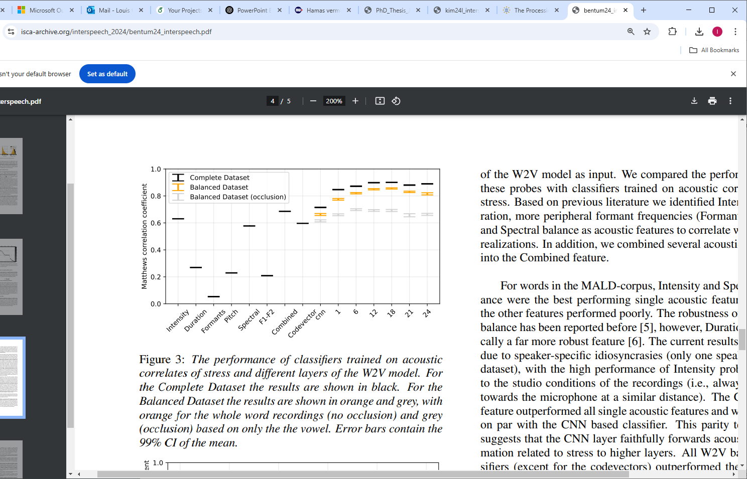

Slide 8
We investigated to what extent W2V ’generates’ abstract representations of stress. First, a test with codevectors (based on the CNN output), revealed that at the early processing stages, stress is ’fractionated’ into vowel specific representations (see Figure 2). This finding was corroborated by a leave-one-out and leave-one-in experiment, revealing that codevector based stress representation do not generalize well over different vowels. In contrast, the result for leave-one-(in or out) with the classifier based on Transformer layer 18 showed that these representations generalize over different vowels in a much better way, which suggests that, at this stage in the model, stress representations are more abstract (see Figure 4). Furthermore, we tested the context-sensitivity of the different W2V layers by comparing results for occluded materials (with only the vowel present) to those obtained with intact recordings. We found a clear effect of occlusion and as expected, this was most pronounced for higher W2V layers (see Figure 3, orange vs. grey).

